Slide 1
Well-Child Measure Highlight

Slide 2
Agenda
Background, Focus & Objectives
Measure Descriptions
Best & Promising Practices
Pay-for-Performance (P4P)
Resources
Sharing Best Practices: LifeLong

Slide 3
Background
CA Governor Newsom’s focus: preventive health for children
DHCS increased accountable measures related to children
DHCS’s Goals:
  Close racial/ethnic disparities in well-child visits and immunizations by 50%.
  Ensure all health plans exceed the 50th percentile for all children’s preventive care measures.
Resource: The California Department of Health Care Services (DHCS). (2022). Comprehensive Quality Strategy. DHCS. https://www.dhcs.ca.gov/services/Pages/DHCS-Comprehensive-Quality-Strategy.aspx
Notes:
Dr. Mendoza, we want to help providers understand that the emphasis behind the measures is the push from the state that we’re upholding. Of course, the push from the state to focus more on children ties into our Mission & Values (next slide, slide 4).

Slide 4

Mission
Improving the health and well-being of our members by collaborating with our provider and community partners to deliver high quality and accessible services.
Vision
All residents of Alameda County will achieve optimal health and well-being at every stage of life.

Slide 5
Today’s Focus
Primary Measures
Well-Child Visits in the First 0-15 Months of life (W30-6+)
Well-Child Visits in the First 15-30 Months of life (W30-2+)
Correlating Measures
Childhood Immunization Status-Combination 10 (CIS-10)
Developmental Screening in the First Three Years of Life (DEV)
Lead Screening in Children (LSC)
Topical Fluoride for Children (TFL-CH)

Slide 6
Objectives
At the end of this webinar, you will be able to:
Have a better understanding of the well-child measure definitions.
Walk away with tactics to promote preventative measures.
Identify best and promising practices that can be used to in your practices.

Slide 7
Measure Descriptions
Measure definitions per NCQA (HEDIS) and CMS

Slide 8
Well-Child Visits in the First 0-30 Months of Life
First 0-15 Months of Life (W30-6+)
  HEDIS: % of children, by 15 months, during 2023 who had at least 6 well-visits with a primary care physician.
First 15-30 Months of Life (W30-2+)
  HEDIS: % of children, 15-30 months, during 2023 who had at least 2 well-visits with a primary care physician.

Slide 9
…continued W30
Notes:
Follows periodicity outlined in Bright Futures Clinical Guidelines.
  14-Day Rule: HEDIS specifications require that visits must be at least 14-days apart.
Telehealth: Visits count towards this measure.
  For billing guidance: 2023 P4P Program Quick Reference Guide for Billing.
All well-visits are reimbursed between 0-30 months of life.

Slide 10
Childhood Immunization Status-Combination 10 (CIS-10)
HEDIS: % of children whose 2nd birthday falls within 2023 who had:
Dose # | Immunization
4 | diphtheria, tetanus and acellular pertussis (Dtap)
3 | polio (IPV)
1 | measles, mumps and rubella (MMR)
3 | haemophilus influenza type B (HiB)
3 | hepatitis B (HepB)
1 | chicken pox (VZV)
4 | pneumococcal conjugate (PCV)
1 | hepatitis A (HepA)
2-dose series or 3-dose series | rotavirus (RV)
2 | influenza (flu) vaccines

Slide 11
…continued CIS-10
Tips:
Follows immunization periodicity outlined in CDC Immunization Schedules and Bright Futures Clinical Guidelines.
Medical Record Notations:
Immunization | Note
Flu | 1 of the 2 can be a Live-Attenuated Influenza Vaccination (LAIV)
HepB | While documenting, indicate if the child received the “immunization at delivery,” “in the hospital,” or “at birth.” Include the date of service.
Combination Vaccines | For those that require more than one antigen (e.g., Dtap and MMR). Document evidence that all components were given of all antigens.
All Immunizations | If antigen was received, document specific antigen and date of immunization in the California Immunization Registry (CAIR2)

Slide 12
Developmental Screening in the First Three Years of Life (DEV)
CMS: % of children screened for risk of developmental, behavioral, and social delays using a standardized screening tool in the 12 months prior or on their 1st, 2nd, or 3rd birthday.
Notes:
Use claim code 96110

Slide 13
Lead Screening in Children (LSC)
HEDIS: % of children, by 24 months, who had >1 blood tests (capillary or venous) for lead poisoning in 2023.
Medical Record Notations:
Include:
Date(s) of the test
Result(s)

Slide 14
Topical Fluoride for Children (TFL-CH)
CMS: % of children, 1-20 yo, who received at least 2 topical Fluoride Varnish (FV) applications in 2023.
Tooth Decay
Most common chronic disease and greatest unmet health need.
An infectious disease that can be transmitted from mothers.
Alameda County STATS
50% of Medi-Cal children, 6-20 yo, had a dental visits
50% of Medi-Cal pregnant women utilize dental services.
Asian & Black/African Americans, 0-5 yo, in selected WIC programs have a higher prevalence of untreated tooth decay
Latinas & Black/African-Americans, and those with lower educational attainment, are less likely to use dental services during pregnancy
Resource: Office of Dental Health, Alameda County Public Health Department. (2019). Alameda County Oral Health Strategic Plan 2019-24. Office of Dental Health, Alameda County Public Health Department.. http://www.acgov.org/board/bos_calendar/documents/DocsAgendaReg_1_28_19/HEALTH%20CARE%20SERVICES/Regular%20Calendar/Item_1_2_Oral_Health_Strategic_Plan_DRAFT.pdf
Notes:
Tooth Decay
Tooth decay is the most common chronic disease and the greatest unmet health need among children in California
Tooth decay is an infectious disease that can be transmitted from mothers to their infants
Alameda County STATS
1/2 of the Medi-Cal eligible children ages 6 - 20 in Alameda Co had a dental visit during the past year (2016 data).
1/2 pregnant women in the Medi-Cal program utilize dental services.
Asian & Black/African Americans age 0-5 in selected WIC programs have a higher prevalence of untreated tooth decay compared to their counterparts.
Latinas, Blacks/ African-Americans and those with lower educational attainment are less likely to use dental services during pregnancy than their counterparts
Resource:
Office of Dental Health, Alameda County Public Health Department. (2019). Alameda County Oral Health Strategic Plan 2019-24. Office of Dental Health, Alameda County Public Health Department.. http://www.acgov.org/board/bos_calendar/documents/DocsAgendaReg_1_28_19/HEALTH%20CARE%20SERVICES/Regular%20Calendar/Item_1_2_Oral_Health_Strategic_Plan_DRAFT.pdf

Slide 15
…continued TFL-CH
Billing Tip:
Measure captured by claims; CPT 99188
  Reimbursement: 125% of Medi-Cal Rate
FV Implementation
Promote oral health & FV application during Prenatal visits.
Combine FV applications with well-child visits.
Oral Health Patient Education.
Pediatric Dental Referral Network accepting Denti-Cal.
Alliance to host virtual training with Alameda County Office of Dental Health.
Alameda County Office Dental Health provides training:
  Phone: (510) 208-5910
  Email: dentalhealth@acgov.org
Notes:
Billing Tip:
Measure captured by claims; CPT 99188
The Alliance reimburses directly contracted PCPs for FV at 125% of Medi-Cal rates.
FV Implementation
Promote oral health & FV application during Prenatal visits.
Combine FV applications with well-child visits and vaccines.
MA’s can apply FV
Oral Health Patient Education
Early Preventive steps
FV in primary care
Dental referral – 1st birthday
Pediatric Dental Referral Network accepting Denti-Cal
Alameda County can Train Providers and Staff
Oral health and FV applications in Primary Care
County Contact #:

Slide 16
Best & Promising Practices
Tips and tricks to improve processes and measure rates

Slide 17
Claims
Tips for billing claims

Slide 18
Submitting Claims
If a patient is coming in for a sick visit, and due for a well-visit, conduct the well-visit at the same time.
Use coding to document exclusions.
Submit claims and encounter data timely.

Slide 19
Tips & Tricks
From Alliance Network Providers

Slide 20
Electronic Medical/Health Record Systems
Utilize health/flag alerts.
Conduct chart scrubbing prior to visits.
Utilize standardized templates.
Notes:
Utilize health/flag alerts for patients who are due for their screening services.
Conduct chart scrubbing prior to visits.
Utilize standardized templates to guide the team through the visit.

Slide 21
Increasing Access
Reduce waiting times:
  Immunization clinics.
  After hours and/or weekend clinics.
  Organize/join health fairs.
Offer back-to-back sibling well-visits.
Strengthen partnership with schools.
Use dedicated exam rooms.
Notes:
Reduce waiting times:
Immunization clinics.
After hours and/or weekend clinics to accommodate work schedules.
Organize/join health fairs with childcare, food, and clinic availability.
Offer back-to-back sibling well-visits for families with multiple children.
Strengthen partnership with schools and after school programs.
Use dedicated rooms for acute visits and well-visits.

Slide 22
Equity Approaches
Consider using an equity approach to increase access for targeted communities:
Review well-care visit measure completion rate factors
Screen for health-related social needs.
Design member information to be equitable.
Involve patients and their family members in decision-making.
Leverage shared decision-making, teach-back and motivational interviewing tools.
Partner with local community resources.
Utilize Community Health Workers (CHW).
Notes:
Consider using an equity approach to increase access for targeted communities:
Review well-care visit measure completion rate factors: race, ethnicity, location (i.e., zip code), and preferred language.
Screen for health-related social needs as part of a comprehensive needs assessment and share information about transportation and interpreter services.
Design member information to be consistent, welcoming, clear and person-centered, language appropriate, and delivered in traditional and electronic format, per patient’s preference.
Involve patients and their family members in decision-making, tailor care to reflect their goals, values, and capacity, as well as the social context of their community.
Leverage shared decision-making, teach-back and motivational interviewing tools.
Partner with local agencies, schools, after-school programs, faith-based organizations and culturally responsive community agencies.
Utilize Community Health Workers (CHW) to help educate, provide culturally appropriate material, support, navigate and encourage scheduling well-visits. This is also a reimbursable benefit from the Alliance.

Slide 23
Communication & Education
Schedule next appointments as soon as possible.
Utilize clinicians and staff to educate parents.
Huddle with staff often to discuss requirements.
Outreach to, and remind, parents.
Notes:
Schedule next appointments before patient/parent leaves the office or while “waiting” to be seen.
Utilize clinicians and staff to educate parents about required screenings and well-visits.
Provide handouts, in their language, to reinforce education.
Huddle with staff often to discuss requirements for well-visits, immunizations, screenings, and treatments.
Share talking points on a paper or electronic template.
Outreach to, and remind, parents via phone calls, letters, and text messaging (if available).
Follow-up with patients who no show or cancel.

Slide 24
Pay-for-Performance (P4P) Program
Measurement Year (MY) 2023

Slide 25
Measures in P4P
Background
Tied into DCHS Managed Care Accountability Set (MCAS) Metrics
Supports the Alliance’s Mission & Vision
Promotes Quality Care and Preventive Care
Child & Adolescent Measures in the P4P
Child and Adolescent Well-Care Visits (WCV) | Well-Child Visits in the First 15 Months of Life (W30-2+)
Childhood Immunizations Status – Combination 10 (CIS-10) | Well-Child Visits in the First 15-30 Months of Life (W30-6+)
Immunizations for Adolescents: Combination 2 (IMA-2) | Lead Screening in Children (LSC)

Slide 26
Resources
Resources from the Alliance

Slide 27

Health Education
Patient Health & Wellness Education
  Live Healthy Library: online materials and links
  Provider Resource Guide: health programs and community resources
  Wellness Program & Materials Request Form: request mailed materials
Request mailed care books like this one via the Wellness Program & Materials Request Form.

Slide 28
Care Coordination
Help Me Grow First 5, Alameda County
Ages: Birth – 5 years
Measures: W30, WCV (2-5 years of age)
Services:
  Outreach to families
  Promote importance of well-visits
  Support scheduling appointments
Contact: DeptQITeam@alamedaalliance.org
Notes:
The Alliance has partnered with Alameda County’s First 5 Help Me Grow Program to conduct care coordination as it pertains to well-child visits, for ages 0-5 years.
The services they provide are to outreach to families to help provide education on the importance of well-visits, and support scheduling appointments.
This is a great resource, and extra hand, that can help in scheduling and coordinating these appointments timely. If you’re interested in having this with your office, please outreach to the QI Team with the email address on the slide.

Slide 29
Reports
Gap in Care Lists
HEDIS
Initial Health Appointment (IHA)
Emergency Department Utilization
Project Support
Quality Improvement Team
Project Management
  Contact: DeptQITeam@alamedaalliance.org

Slide 30
Upcoming Webinars
Measure Highlights
All sessions are from Noon – 1 p.m.
March 15, 2023: FUA/FUM
May 17, 2023: W30
May 24, 2023: FUA/FUM
RSVP: bit.ly/3Y3Dckz
Contact: DeptQITeam@alamedaalliance.org

Slide 31
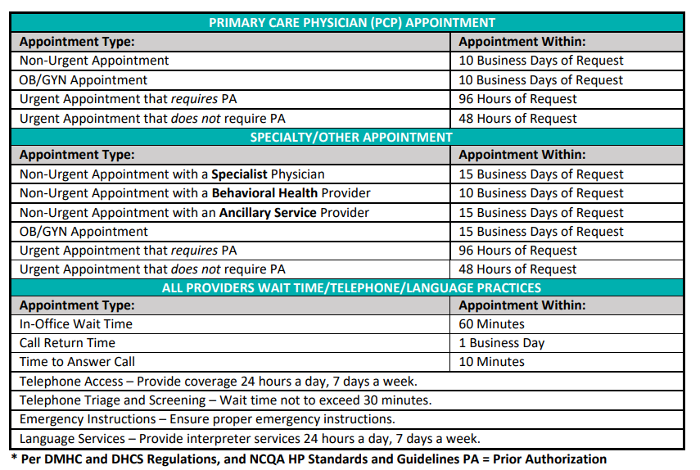
Access Standards

Slide 32
Sharing Best Practices
LifeLong William Jenkins Health Center
Omoniyi Omotoso, MD, MPH, FAAP
Associate Director of Pediatrics

Slide 33
Thanks!
Questions?
You can contact us at:
DeptQITeam@alamedaalliance.org

